Slide 1
Welcome to CSE225
Muhammad Shafayat Oshman (MUO)

Slide 2
Instructor Info
MCS from Carleton University and BSc from NSU
Worked with Ericsson Canada for 1.5 years
Main area of work is Security Metrics in Cloud Environments
More info -> shafayatoshman.ca
Office: SAC1181
Email: muhammad.oshman@northsouth.edu

Slide 3
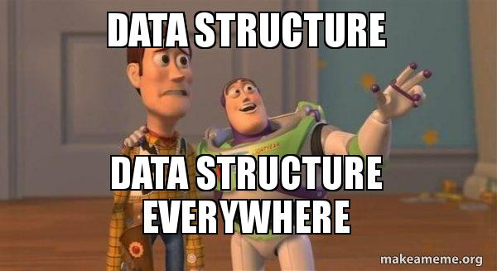
About the course
This course is introduction to the basic “Data Structures” used in programming.
Introduce the concept of “Algorithms”.
Introduce algorithm analysis through Big-O notations.

Slide 4
Course Info
Book: C++ Data Structures by Nell Dale
Course Materials: To be posted on Canvas (if necessary)
Noting down class lectures is VERY IMPORTANT!
For additional info, see course website: https://shafayatoshman.ca/courses/232.CSE225

Slide 5
Grading
Theory
Assignments (Written + Viva) | 20
Quiz | 10
Mid-term | 20
Lab | 20
Final | 30

Slide 6


Slide 7
Policies
NSU Code of Conduct: http://www.northsouth.edu/proctoroffice/
Additional policies: https://shafayatoshman.ca/courses/232.CSE225

Slide 8
